Slide 1

Bank Loan Analytics

Slide 2
Agenda
Introduction
Objectives of Study
KPI Analysis
Dashboard
Area of focus
Presentation Title

Slide 3

Introduction
Bank loan analysis is performed to evaluate the creditworthiness of prospective borrowers and assess the risks involved in lending them money.
Banks examine several factors, including the borrower's credit history, income, debt-to-income ratio, collateral, and overall financial health, to make well-informed decisions on loan approval and the terms (such as interest rates and repayment schedules).
This process helps banks reduce the risk of defaults and make prudent lending choices, safeguarding their assets and maintaining profitability.

Slide 4


The objectives are to generate valuable insights using various tools like Power BI, Tableau, Excel, and SQL to optimize banking operations by:
Analysing customer behaviour.
Ensuring the maintenance of appropriate loans while minimizing bad loans.
Identifying and measuring potential risks associated with lending.
Making lending decisions that strike a balance between risk and return.
Discovering additional areas for improvement.
Objectives of Study

Slide 5
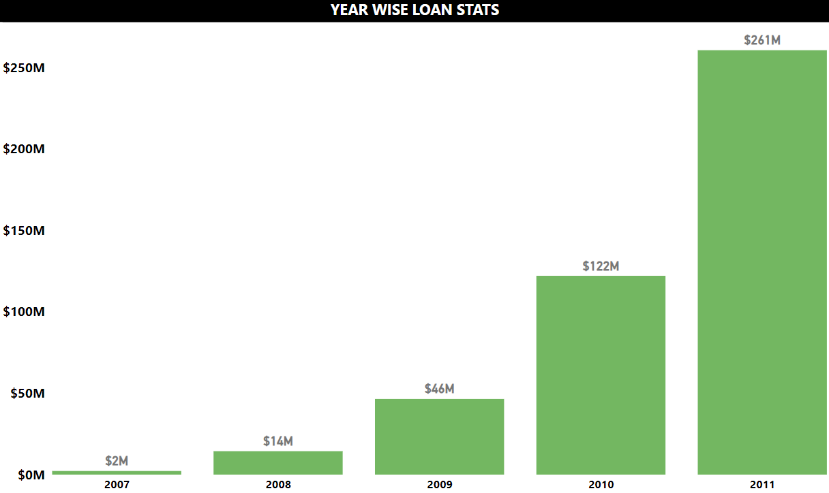
KPI 1-Year wise loan amount stats

Slide 6
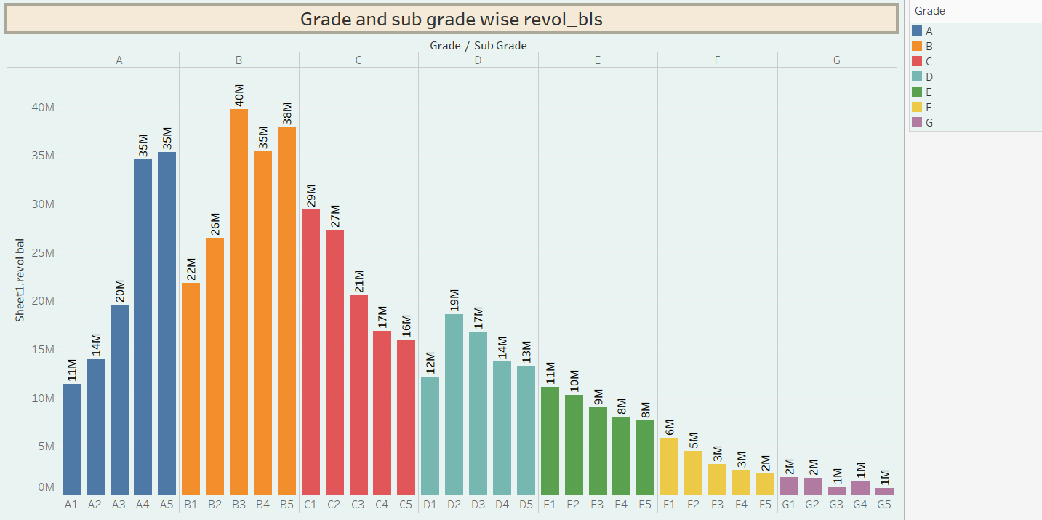
KPI 2-Grade & sub-grade wise Revol_Bal

Slide 7
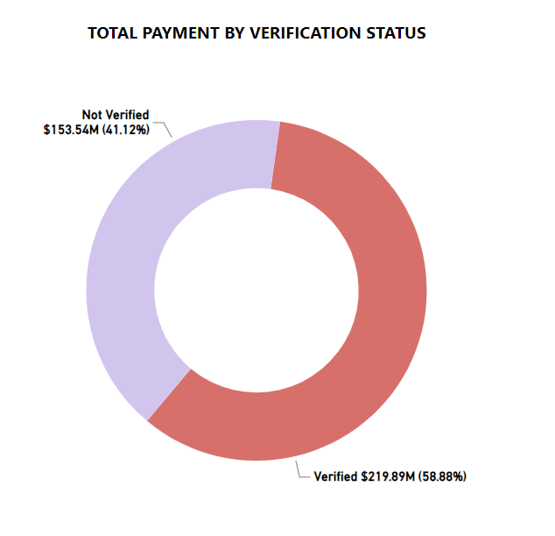
KPI 3-Verified & non-verified status

Slide 8
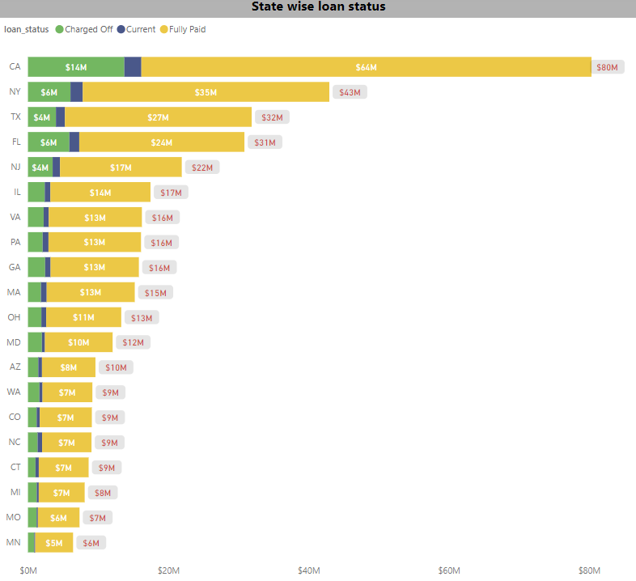
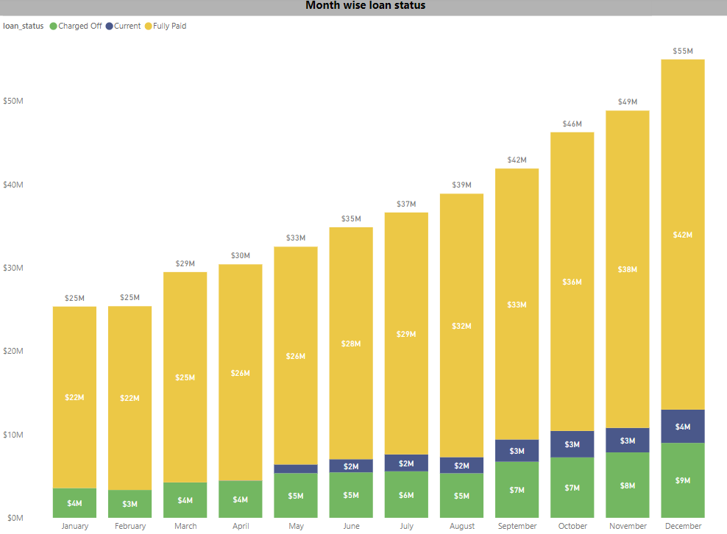
KPI 4-State & month wise loan status

Slide 9
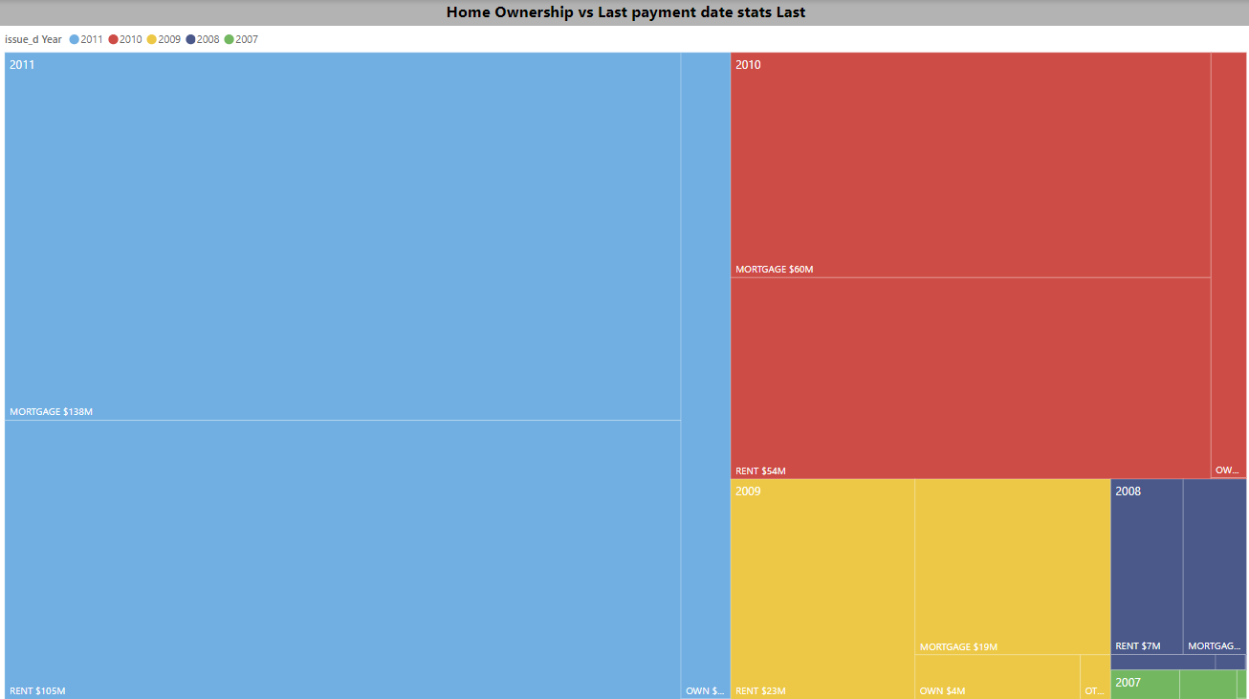
KPI 5-Home ownership vs last payment stats

Slide 10
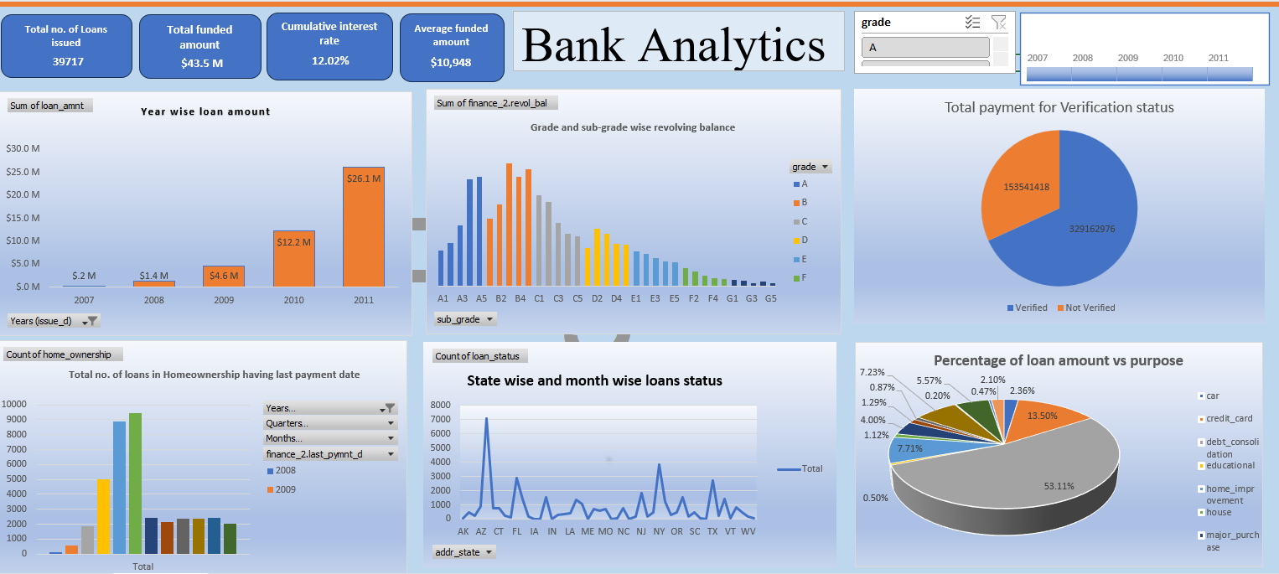
Excel Dashboard

Slide 11
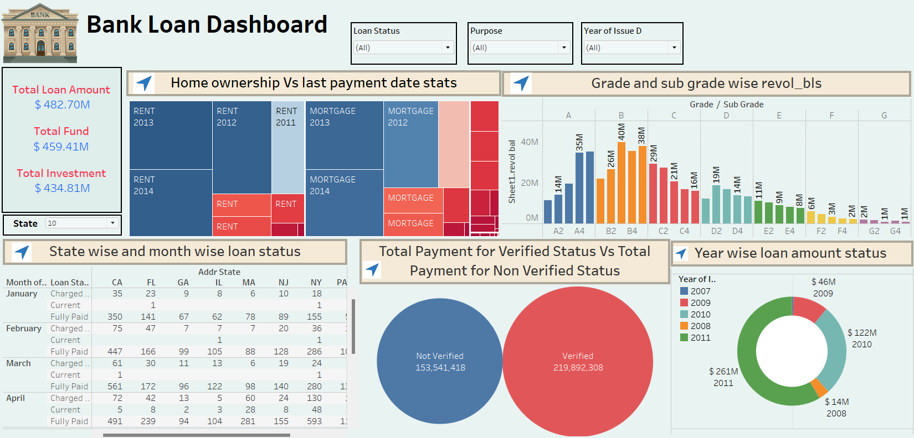
Tableau Dashboard

Slide 12
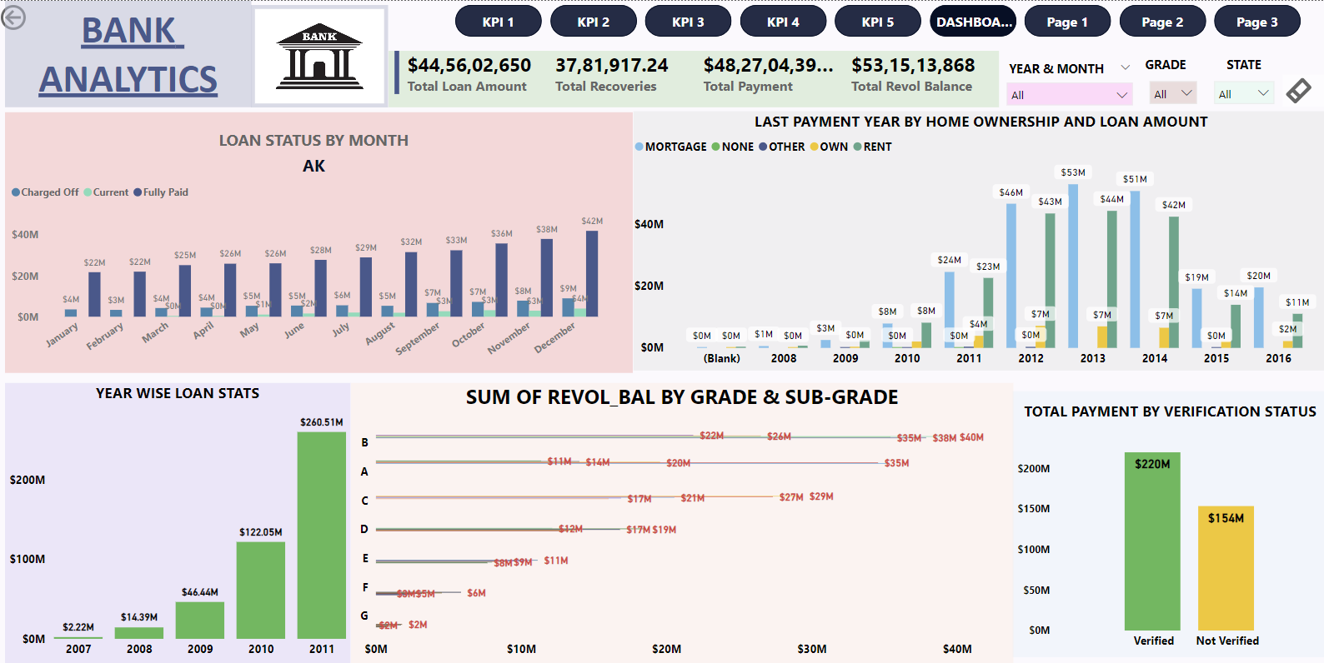
Power BI Dashboard

Slide 13
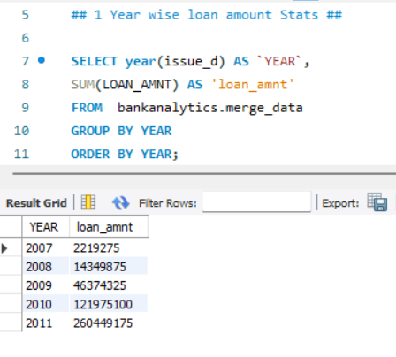
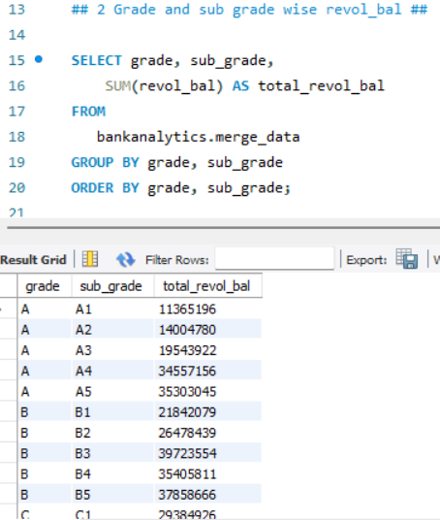
SQL

Slide 14
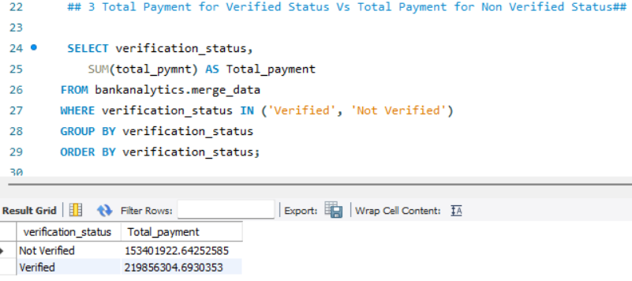
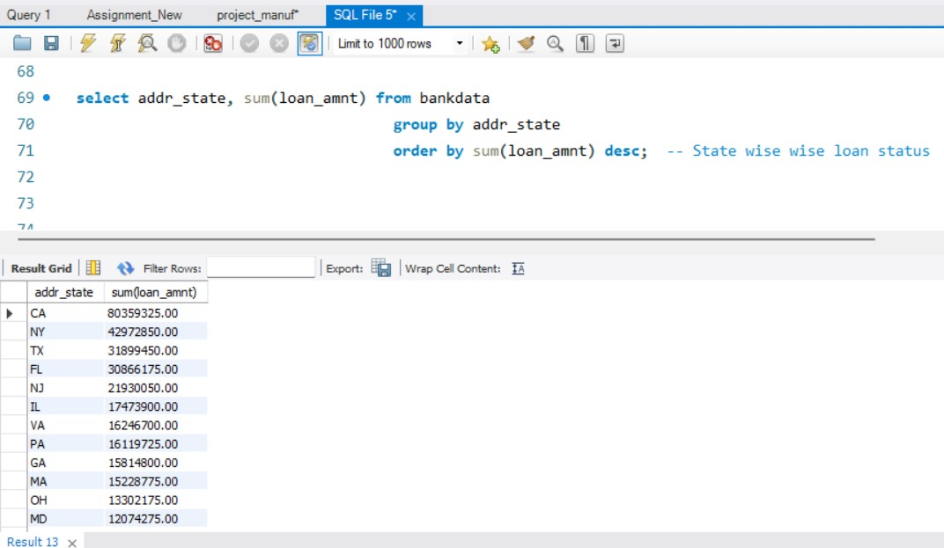
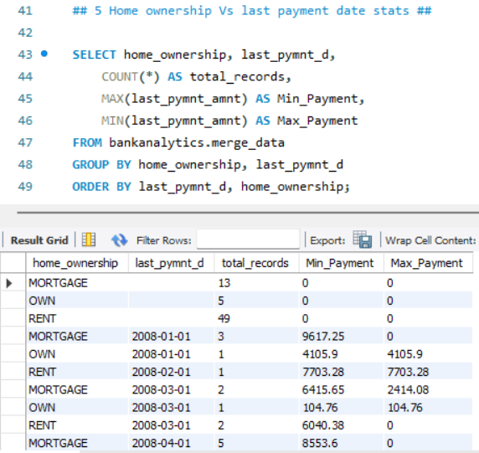
SQL

Slide 15

Areas of Focus
Analyzing loan demand across various sectors and demographics to effectively identify and target potential borrowers.
Provide attractive interest rates and favorable terms to stay competitive in the market.
Make the loan application and approval process simpler and faster to improve customer experience and encourage more borrowers to apply.
Establish strong credit risk assessment and management practices to reduce defaults and keep a healthy loan portfolio.

Slide 16




Thank you

